Slide 1
JavaScript Introduction
JavaScript was designed to add interactivity to HTML pages
JavaScript is a scripting language
A scripting language is a lightweight programming language
JavaScript is usually embedded directly into HTML pages
JavaScript is an interpreted language (means that scripts execute without preliminary compilation)
Developed by Netscape Corporation known as “Live Script”
It was later renamed to its present name by Netscape, which
had a joint venture with Sun Microsystems
JavaScript supports server-side scripting also, separately known as Livewire
First supported in Netscape Navigator 2.0.
Now - Internet Explorer from Microsoft, Personal Web Client
3.0 from Lotus and Mosaic 2.0 and so on.
JavaScript was also referred to as ECMA Script. ECMA is the short form for European Computer Manufacturer’s Association.

Slide 2
What can a JavaScript do?
JavaScript gives HTML designers a programming tool - HTML authors are normally not programmers, but JavaScript is a scripting language with a very simple syntax! Almost anyone can put small "snippets" of code into their HTML pages
JavaScript can put dynamic text into an HTML page - A JavaScript statement like this: document.write("<h1>" + name + "</h1>") can write a variable text into an HTML page
JavaScript can react to events - A JavaScript can be set to execute when something happens, like when a page has finished loading or when a user clicks on an HTML element
JavaScript can read and write HTML elements - A JavaScript can read and change the content of an HTML element
JavaScript can be used to validate data - A JavaScript can be used to validate form data before it is submitted to a server. This saves the server from extra processing
JavaScript can be used to detect the visitor's browser - A JavaScript can be used to detect the visitor's browser, and - depending on the browser - load another page specifically designed for that browser
JavaScript can be used to create cookies - A JavaScript can be used to
store and retrieve information on the visitor's computer

Slide 3
Limitations with JavaScript
Client-side JavaScript does not allow the reading or writing of files. This has been kept for security reason.
JavaScript can not be used for Networking applications because there is no such support available.
JavaScript doesn't have any multithreading or multiprocess capabilities.

Slide 4
JavaScript Vs Java
JavaScript has nothing to do with Java language
Java is purely an object-oriented language, JavaScript is just a scripting tool
JavaScript is not compiled and executed; the client directly interprets it
JavaScript is a freely typed language whereas Java is a strongly typed one
Object references must exist at compile-time in Java (static binding) whereas they are checked only at runtime in JavaScript (dynamic binding)

Slide 5
Advantages of JavaScript
Less server interaction: You can validate user input before sending the page off to the server. This saves server traffic, which means less load on your server.
Immediate feedback to the visitors: They don't have to wait for a
page reload to see if they have forgotten to enter something.
Increased interactivity: You can create interfaces that react when the user hovers over them with a mouse or activates them via the keyboard.
Richer interfaces: You can use JavaScript to include such items as drag-and-drop components and sliders to give a Rich Interface to your site visitors.
Control the frame navigation
Include a plug-in or a java applet inside a page
Form validation in the client’s place itself, thereby reducing the
burden on the server
Images can swap when the user moves a mouse over them,
Calculations can be made without having to resort to a cgi script
Javascript timer on the client to check how much time he/she takes to fill a form.
Apart from all these advantages, javascript is very easy to learn.

Slide 6
JavaScript Syntax
A JavaScript consists of JavaScript statements that are placed within the <script>... </script> HTML tags in a web page.
You can place the <script> tag containing your JavaScript anywhere within you web page but it is preferred way to keep it within the
<head> tags.
The <script> tag alert the browser program to begin interpreting all the text between these tags as a script. So simple syntax of your.

Slide 7
JavaScript Syntax
The script tag takes two important attributes:
language: This attribute specifies what scripting language you are using. Typically, its value will be javascript. Although recent versions of HTML (and XHTML, its successor) have phased out the use of this attribute.
type: This attribute is what is now recommended to indicate the scripting language in use and its value should be set to "text/javascript".

Slide 8
JavaScript Placement in HTML File
<html>
<body>
<script language="javascript" type="text/javascript">
JavaScript code
</script>
</body>
</html>

Slide 9
JavaScript Placement in HTML File
There is a flexibility given to include JavaScript code anywhere in an HTML document. But there are following most preferred ways to include JavaScript in your HTML file.
Script in <head>...</head> section.
Script in <body>...</body> section.
Script in and external file and then include in
<head>...</head> section.

Slide 10
JavaScript in <head></head> section
<html>
<head>
<script type="text/javascript"> function sayHello()
{
alert("Hello World")
}</script>
</head>
<body><input type="button" onclick="sayHello()" value="Say Hello“ > </body> </html>

Slide 11
JavaScript in <body></body> section:
<html> <head> </head>
<body>
<script type="text/javascript“> document.write("Hello World“)
</script> <p>This is web page body </p>
</body>
</html>

Slide 12
JavaScript in External File
<html> <head>
<script type="text/javascript" src="filename.js”>
</script>
</head>
<body> ....... </body>
</html>

Slide 13
JavaScript Variables and DataTypes
JavaScript variables are "containers" for storing information.
Variable names must begin with a letter
Variable names can also begin with $ and _.
Variable names are case sensitive.
JavaScript variables can also hold other types of data, like text values .
In JavaScript a text like "John Doe" is called a string.
When you assign a text value to a variable, put double or single quotes around the value.
When you assign a numeric value to a variable, do not put quotes around the value. If you put quotes around a numeric value, it will be treated as text.

Slide 14
JavaScript Data Types
String, Number, Boolean, Array, Object, Null, Undefined.
JavaScript Has Dynamic Types
JavaScript has dynamic types. This means that the same variable can be used as different types.
var x
var x = 5;
// Now x is undefined
// Now x is a Number
var x = "John"; // Now x is a String
JavaScript Strings
A string is a variable which stores a series of characters like "John Doe".
A string can be any text inside quotes. You can use single or double quotes:

Slide 15
JavaScript Numbers
JavaScript has only one type of numbers. Numbers can be written with, or without decimals:
var x1=34.00;
var x2=34;
//Written with decimals
//Written without decimals
Extra large or extra small numbers can be written with scientific (exponential) notation.
var y=123e5;
var z=123e-5;
// 12300000
// 0.00123
JavaScript Booleans
Booleans can only have two values: true or false. Booleans are often used in conditional testing. You will learn more about conditional testing in a later chapter of this tutorial.
var x=true var y=false

Slide 16
JavaScript Arrays
var cars=new Array(); cars[0]="Saab";
cars[1]="Volvo";
cars[2]="BMW";
or (condensed array):
var cars=new Array("Saab","Volvo","BMW");
JavaScript Objects
An object is delimited by curly braces. Inside the braces the object's properties are defined as name and value pairs (name : value). The properties are separated by commas:
var person={firstname:"John", lastname:"Doe", id:5566};
name=person.lastname; name=person["lastname"];

Slide 17
Undefined and Null
Undefined is the value of a variable with no value.
Variables can be emptied by setting the value to null.
cars=null; person=null;
Declaring Variable Types
When you declare a new variable, you can declare its type using
the "new" keyword:
JavaScript variables are all objects. When you declare a variable you create a new object.
var carname=new String;
var x= var y= var cars=
new Number; new Boolean; new Array;
var person= new Object;

Slide 18
JavaScript Variable Scope
The scope of a variable is the region of your program in which it is defined. JavaScript variables have only two scopes.
Global Variables: A global variable has global scope which means it can be defined anywhere in your JavaScript code.
Local Variables: A local variable will be visible only within a function where it is defined. Function parameters are always local to that function.
Within the body of a function, a local variable takes precedence over a global variable with the same name. If you declare a local variable or function parameter with the same name as a global variable, you effectively hide the global variable. Take a look into the following example.
<script type="text/javascript">
<!--
var myVar = "global"; // Declare a global variable function checkscope( ) {
var myVar = "local"; // Declare a local variable document.write(myVar);
}
//-->
</script>
It will produce the following result:
Local
JavaScript Variable Names
While naming your variables in JavaScript, keep the following rules in mind.

Slide 19
Operators
Addition (+)
Subtraction (-)
Multiplication (*)
Division (/)
Modulus (%)
String concatenation operator is “+”
Pre-increment operator and post-increment operators (++)
Pre-decrement and post-decrement operators (--)
NOT ( ! )
AND ( && )
OR ( || )
Identity ( === )
Non identity (!= )

Slide 20
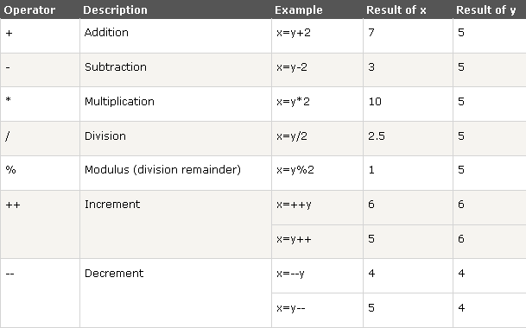
JavaScript Arithmetic Operators

Slide 21
What is an Operator?
Let us take a simple expression 4 + 5 is equal to 9. Here 4 and 5 are called operands and ‘+’ is called the operator. JavaScript supports the following types of operators.
Arithmetic Operators
Comparison Operators
Logical (or Relational) Operators
Assignment Operators
Conditional (or ternary) Operators
Let’s have a look at all the operators one by one.
Arithmetic Operators
JavaScript supports the following arithmetic operators: Assume variable A holds 10 and variable B holds 20, then:
S. No. | Operator and Description
1 | + (Addition) Adds two operands Ex: A + B will give 30
2 | - (Subtraction) Subtracts the second operand from the first Ex: A - B will give -10

Slide 22
3 | * (Multiplication) Multiply both operands Ex: A * B will give 200
4 | / (Division) Divide the numerator by the denominator Ex: B / A will give 2
5 | % (Modulus) Outputs the remainder of an integer division Ex: B % A will give 0
6 | ++ (Increment) Increases an integer value by one Ex: A++ will give 11
7 | -- (Decrement) Decreases an integer value by one Ex: A-- will give 9
Note: Addition operator (+) works for Numeric as well as Strings. e.g. "a" + 10 will give "a10".
Example
The following code shows how to use arithmetic operators in JavaScript.
<html>
<body>
<script type="text/javascript">
<!--
var a = 33;

Slide 23
var b = 10; var c = "Test";
var linebreak = "<br />";
document.write("a + b = "); result = a + b; document.write(result); document.write(linebreak);
document.write("a - b = "); result = a - b; document.write(result); document.write(linebreak);
document.write("a / b = "); result = a / b; document.write(result); document.write(linebreak);
document.write("a % b = "); result = a % b; document.write(result); document.write(linebreak);
document.write("a + b + c = "); result = a + b + c; document.write(result); document.write(linebreak);

Slide 24
a = a++; document.write("a++ = "); result = a++;
document.write(result); document.write(linebreak);
b = b--; document.write("b-- = "); result = b--; document.write(result); document.write(linebreak);
//-->
</script>
<p>Set the variables to different values and then try...</p>
</body>
</html>
Output
a + b = 43 a - b = 23 a / b = 3.3 a % b = 3
a + b + c = 43Test a++ = 33
b-- = 10
Set the variables to different values and then try...

Slide 25
Comparison Operators
JavaScript supports the following comparison operators: Assume variable A holds 10 and variable B holds 20, then:
S.No | Operator and Description
1 | == (Equal) Checks if the value of two operands are equal or not, if yes, then the condition becomes true. Ex: (A == B) is not true.
2 | != (Not Equal) Checks if the value of two operands are equal or not, if the values are not equal, then the condition becomes true. Ex: (A != B) is true.
3 | > (Greater than) Checks if the value of the left operand is greater than the value of the right operand, if yes, then the condition becomes true. Ex: (A > B) is not true.
4 | < (Less than) Checks if the value of the left operand is less than the value of the right operand, if yes, then the condition becomes true. Ex: (A < B) is true.
5 | >= (Greater than or Equal to) Checks if the value of the left operand is greater than or equal to the value of the right operand, if yes, then the condition becomes true. Ex: (A >= B) is not true.

Slide 26
6 | <= (Less than or Equal to) Checks if the value of the left operand is less than or equal to the value of the right operand, if yes, then the condition becomes true. Ex: (A <= B) is true.
Example
The following code shows how to use comparison operators in JavaScript.
<html>
<body>
<script type="text/javascript">
<!--
var a = 10; var b = 20;
var linebreak = "<br />";
document.write("(a == b) => "); result = (a == b); document.write(result); document.write(linebreak);
document.write("(a < b) => "); result = (a < b); document.write(result); document.write(linebreak);
document.write("(a > b) => "); result = (a > b); document.write(result); document.write(linebreak);

Slide 27
document.write("(a != b) => "); result = (a != b); document.write(result); document.write(linebreak);
document.write("(a >= b) => "); result = (a >= b); document.write(result); document.write(linebreak);
document.write("(a <= b) => "); result = (a <= b); document.write(result); document.write(linebreak);
//-->
</script>
<p>Set the variables to different values and different operators and then try...</p>
</body>
</html>
Output
(a == b) => false (a < b) => true (a > b) => false (a != b) => true (a >= b) => false

Slide 28
(a <= b) => true
Set the variables to different values and different operators and then try...
Logical Operators
JavaScript supports the following logical operators: Assume variable A holds 10 and variable B holds 20, then:
S.No | Operator and Description
1 | && (Logical AND) If both the operands are non-zero, then the condition becomes true. Ex: (A && B) is true.
2 | || (Logical OR) If any of the two operands are non-zero, then the condition becomes true. Ex: (A || B) is true.
3 | ! (Logical NOT) Reverses the logical state of its operand. If a condition is true, then the Logical NOT operator will make it false. Ex: ! (A && B) is false.
Example

Slide 29
Try the following code to learn how to implement Logical Operators in JavaScript.
<html>
<body>
<script type="text/javascript">
<!--
var a = true; var b = false;
var linebreak = "<br />";
document.write("(a && b) => "); result = (a && b); document.write(result); document.write(linebreak);
document.write("(a || b) => "); result = (a || b); document.write(result); document.write(linebreak);
document.write("!(a && b) => "); result = (!(a && b)); document.write(result); document.write(linebreak);
//-->
</script>

Slide 30
<p>Set the variables to different values and different operators and then try...</p>
</body>
</html>
Output
(a && b) => false (a || b) => true
!(a && b) => true
Set the variables to different values and different operators and then try...
Bitwise Operators
JavaScript supports the following bitwise operators: Assume variable A holds 2 and variable B holds 3, then:
S.No | Operator and Description
1 | & (Bitwise AND) It performs a Boolean AND operation on each bit of its integer arguments. Ex: (A & B) is 2.
2 | | (BitWise OR) It performs a Boolean OR operation on each bit of its integer arguments. Ex: (A | B) is 3.
3 | ^ (Bitwise XOR)

Slide 31
 | It performs a Boolean exclusive OR operation on each bit of its integer arguments. Exclusive OR means that either operand one is true or operand two is true, but not both. Ex: (A ^ B) is 1.
4 | ~ (Bitwise Not) It is a unary operator and operates by reversing all the bits in the operand. Ex: (~B) is -4.
5 | << (Left Shift) It moves all the bits in its first operand to the left by the number of places specified in the second operand. New bits are filled with zeros. Shifting a value left by one position is equivalent to multiplying it by 2, shifting two positions is equivalent to multiplying by 4, and so on. Ex: (A << 1) is 4.
6 | >> (Right Shift) Binary Right Shift Operator. The left operand’s value is moved right by the number of bits specified by the right operand. Ex: (A >> 1) is 1.
7 | >>> (Right shift with Zero) This operator is just like the >> operator, except that the bits shifted in on the left are always zero. Ex: (A >>> 1) is 1.
Example
Try the following code to implement Bitwise operator in JavaScript.
<html>
<body>
<script type="text/javascript">

Slide 32
<!--
var a = 2; var b = 3;
// Bit presentation 10
// Bit presentation 11
var linebreak = "<br />";
document.write("(a & b) => "); result = (a & b); document.write(result); document.write(linebreak);
document.write("(a | b) => "); result = (a | b); document.write(result); document.write(linebreak);
document.write("(a ^ b) => "); result = (a ^ b); document.write(result); document.write(linebreak);
document.write("(~b) => "); result = (~b); document.write(result); document.write(linebreak);
document.write("(a << b) => "); result = (a << b); document.write(result); document.write(linebreak);

Slide 33
document.write("(a >> b) => "); result = (a >> b); document.write(result); document.write(linebreak);
//-->
</script>
<p>Set the variables to different values and different operators and then try...</p>
</body>
</html>
Output
(a & b) => 2 (a | b) => 3 (a ^ b) => 1 (~b) => -4
(a << b) => 16 (a >> b) => 0
Set the variables to different values and different operators and then try...
Assignment Operators
JavaScript supports the following assignment operators:
S.No | Operator and Description
1 | = (Simple Assignment ) Assigns values from the right side operand to the left side operand

Slide 34
 | Ex: C = A + B will assign the value of A + B into C
2 | += (Add and Assignment) It adds the right operand to the left operand and assigns the result to the left operand. Ex: C += A is equivalent to C = C + A
3 | -= (Subtract and Assignment) It subtracts the right operand from the left operand and assigns the result to the left operand. Ex: C -= A is equivalent to C = C - A
4 | *= (Multiply and Assignment) It multiplies the right operand with the left operand and assigns the result to the left operand. Ex: C *= A is equivalent to C = C * A
5 | /= (Divide and Assignment) It divides the left operand with the right operand and assigns the result to the left operand. Ex: C /= A is equivalent to C = C / A
6 | %= (Modules and Assignment) It takes modulus using two operands and assigns the result to the left operand. Ex: C %= A is equivalent to C = C % A
Note: Same logic applies to Bitwise operators, so they will become <<=, >>=, >>=, &=, |= and ^=.
Example
Try the following code to implement assignment operator in JavaScript.

Slide 35
<html>
<body>
<script type="text/javascript">
<!--
var a = 33; var b = 10;
var linebreak = "<br />";
document.write("Value of a => (a = b) => "); result = (a = b);
document.write(result); document.write(linebreak);
document.write("Value of a => (a += b) => "); result = (a += b);
document.write(result); document.write(linebreak);
document.write("Value of a => (a -= b) => "); result = (a -= b);
document.write(result); document.write(linebreak);
document.write("Value of a => (a *= result = (a *= b); document.write(result); document.write(linebreak);
b) => ");

Slide 36
document.write("Value of a => (a /= b) => "); result = (a /= b);
document.write(result); document.write(linebreak);
document.write("Value of a => (a %= b) => "); result = (a %= b);
document.write(result); document.write(linebreak);
//-->
</script>
<p>Set the variables to different values and different operators and then try...</p>
</body>
</html>
Output
Value of a => (a = b) => 10 Value of a => (a += b) => 20 Value of a => (a -= b) => 10 Value of a => (a *= b) => 100 Value of a => (a /= b) => 10 Value of a => (a %= b) => 0
Set the variables to different values and different operators and then try...

Slide 37
Miscellaneous Operators
We will discuss two operators here that are quite useful in JavaScript: the
conditional operator (? :) and the typeof operator.
Conditional Operator (? :)
The conditional operator first evaluates an expression for a true or false value and then executes one of the two given statements depending upon the result of the evaluation.
S.No | Operator and Description
1 | ? : (Conditional ) If Condition is true? Then value X : Otherwise value Y
Example
Try the following code to understand how the Conditional Operator works in JavaScript.
<html>
<body>
<script type="text/javascript">
<!--
var a = 10; var b = 20;
var linebreak = "<br />";
document.write ("((a > b) ? 100 : 200) => "); result = (a > b) ? 100 : 200; document.write(result); document.write(linebreak);
document.write ("((a < b) ? 100 : 200) => ");

Slide 38
result = (a < b) ? 100 : 200; document.write(result); document.write(linebreak);
//-->
</script>
<p>Set the variables to different values and different operators and then try...</p>
</body>
</html>
Output
((a > b) ? 100 : 200) => 200
((a < b) ? 100 : 200) => 100
Set the variables to different values and different operators and then try...
typeof Operator
The typeof operator is a unary operator that is placed before its single operand, which can be of any type. Its value is a string indicating the data type of the operand.
The typeof operator evaluates to "number", "string", or "boolean" if its operand is a number, string, or boolean value and returns true or false based on the evaluation.
Here is a list of the return values for the typeof Operator.
Type | String Returned by typeof
Number | "number"
String | "string"

Slide 39
Boolean | "boolean"
Object | "object"
Function | "function"
Undefined | "undefined"
Null | "object"
Example
The following code shows how to implement typeof operator.
<html>
<body>
<script type="text/javascript">
<!--
var a = 10;
var b = "String";
var linebreak = "<br />";
result = (typeof b == "string" ? "B is String" : "B is Numeric"); document.write("Result => ");
document.write(result); document.write(linebreak);
result = (typeof a == "string" ? "A is String" : "A is Numeric"); document.write("Result => ");
document.write(result); document.write(linebreak);

Slide 40
//-->
</script>
<p>Set the variables to different values and different operators and then try...</p>
</body>
</html>
Output
Result => B is String Result => A is Numeric
Set the variables to different values and different operators and then try...

Slide 41
JavaScript Objects
Everything" in JavaScript is an Object: a String, a Number, an Array, a Date.
In JavaScript, an object is data, with properties and methods.
In JavaScript, objects are data (variables), with properties and methods.
var txt = "Hello";
Methods:
txt.indexOf(),txt.length()
Accessing Object Properties
The syntax for accessing the property of an object is:
objectName.propertyName
This example uses the length property of the String object to find the length of a string:
var message="Hello World!"; var x=message.length;

Slide 42
Data Type Conversions
JavaScript is a dynamically typed language
We can convert a number in to string and vice versa
parseInt method - used to convert a string value, which is holding a number data type
temp = parseInt(“42”)
anoth = parseInt(“54.34”)
Str=””+2500;
Str=””+temp;
Simply adding an empty quote to a number value will
convert a number into string data type.

Slide 43
Decision Constructs
If…else
If (condition)
{
statements, if it is true
}
else
{
statements if it is false
}
For Multiple Conditions
if(condition)
{
Statements
}
else if (condition) { statements
}

Slide 44
Sample Program
<script language="JavaScript"> var type;
type=prompt("enter the user type",""); if(type=="admin") document.write("Welcome Administrator"); else if(type=="user") document.write("Welcome user");
else document.write("Sorry…");
</script>

Slide 45
Switch…case
<script language="JavaScript"> var type;
type=prompt("Enter the user type",""); switch(type)
{
case "admin": document.write("Welcome Administrator"); break;
case "user": document.write("Welcome user"); break; default: document.write("Sorry…");
}
</script>

Slide 46
JavaScript Popup Boxes
In JavaScript we can create three kinds of popup boxes: Alert box, Confirm box, and Prompt box.
Alert Box
An alert box is often used if you want to make sure information comes through to the user.
When an alert box pops up, the user will have to click "OK" to proceed.
Syntax:
alert("sometext")
Confirm Box
A confirm box is often used if you want the user to verify or accept something.
When a confirm box pops up, the user will have to click either "OK" or "Cancel" to proceed.
If the user clicks "OK", the box returns true. If the user clicks "Cancel", the box returns false.
Syntax:
confirm("sometext")

Slide 47
Prompt Box
A prompt box is often used if you want the user to input a value before
entering a page.
When a prompt box pops up, the user will have to click either "OK" or "Cancel" to proceed after entering an input value.
If the user clicks "OK" the box returns the input value. If the user clicks
"Cancel" the box returns null.
Syntax:
prompt("sometext","defaultvalue“)

Slide 48
JavaScript Functions
A function is a reusable code-block that will be executed by an event, or when the function is called.
To keep the browser from executing a script when the page loads, you can put your script into a function.
A function contains code that will be executed by an event or by a call to that function.
You may call a function from anywhere within the page (or even from other pages if the function is embedded in an external .js file).

Slide 49
JavaScript Function Syntax
function functionname()
{
some code to be executed
}

Slide 50
JavaScript Functions
A function is a block of code that will be executed when "someone" calls it.
<!DOCTYPE html>
<html>
<head>
<script>
function myFunction()
{
alert("Hello World!");
}
</script>
</head>
<body>
<button onclick="myFunction()">Try it</button>
</body>
</html>

Slide 51
Functions With a Return Value
Sometimes you want your function to return a value back to where the call was made.
This is possible by using the return statement.
When using the return statement, the function will stop executing, and return the specified value.
Calling a Function with Arguments
When you call a function, you can pass along some values to it, these values are called arguments or parameters.
These arguments can be used inside the function.

Slide 52
<button onclick="myFunction(‘Abhishek ',’Professor')">click here</button>
<script>
function myFunction(name,job)
{
alert("Welcome " + name + ", the " + job);
}
</script>

Slide 53
Functions With a Return Value
Sometimes you want your function to return a value back to where the call was made.
This is possible by using the return statement.
When using the return statement, the function will stop executing, and return the specified value.
Syntax
function myFunction()
{
var x=5; return x;
}

Slide 54
Examples
<html>
<head>
<script type="text/javascript"> function product(a,b)
{
return a*b
}
</script>
</head>
<body>
<script type="text/javascript"> document.write(product(4,3))
</script>
<p>The script in the body section calls a function with two parameters (4 and 3).</p>
<p>The function will return the product of these two parameters.</p>
</body>
</html>

Slide 55
JavaScript For...In Statement
The for...in statement is used to loop (iterate) through the elements of an array or through the properties of an object.
The code in the body of the for ... in loop is executed once for each element/property.
Syntax
for (variable in object)
{
code to be executed
}

Slide 56
Example
<html>
<body>
<script type="text/javascript"> var x var mycars = new Array() mycars[0] = "Saab“
mycars[1] = "Volvo“ mycars[2] = "BMW" for (x in mycars)
{
document.write(mycars[x] + "<br />")
}
</script>
</body>
</html>

Slide 57
JavaScript Event
Events are normally used in combination with functions, and the function will not be executed before the event occurs!
By using JavaScript, we have the ability to create dynamic web
pages. Events are actions that can be detected by JavaScript.
Every element on a web page has certain events which can trigger JavaScript functions. For example, we can use the onClick event of a button element to indicate that a function will run when a user clicks on the button.
Examples of events:
A mouse click
A web page or an image loading
Mousing over a hot spot on the web page
Selecting an input box in an HTML form
Submitting an HTML form
A keystroke

Slide 58
JavaScript Event
Each and every element of the form will have some restricted events associated with it
Blur - Button, Checkbox, File Upload, Frame, Layer, Password, Radio, Reset, Select, Submit, Text, Text area, Window
Focus - Button, Checkbox, File Upload, Frame, Layer, Password, Radio, Reset, Select, Submit, Text, Text area, Window
Change - FileUpload, Select, Text, Text area
Click - Button, Checkbox, Document, Links, Radio, Reset, Submit
Double Click - Area, Document, Links
Key Down - Document, Image, Links, Text area
Key Up - Document, Image, Links, Text area

Slide 59
Load - Document, Image, Layer, Window
UnLoad - Document, Window
Error - Window, Image
Mouse Down - Button, Document, Link
Mouse Up - Button, Document, Link
Mouse Over - Area, Layer, Link
Mouse Out - Area, Layer, Link
Submit, Reset - This is for a page
Select - Text, Text Area
Resize - Frame, Window

Slide 60
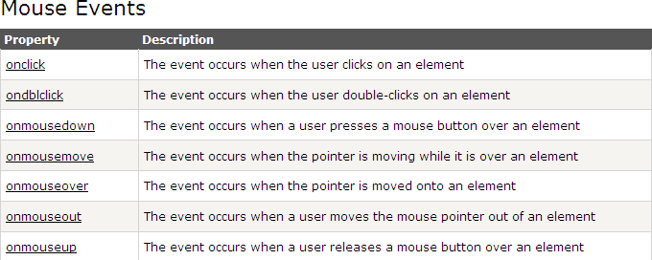

Slide 61
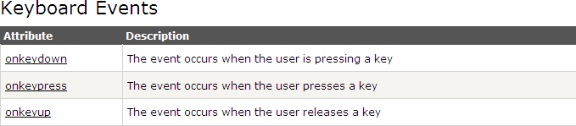

Slide 62
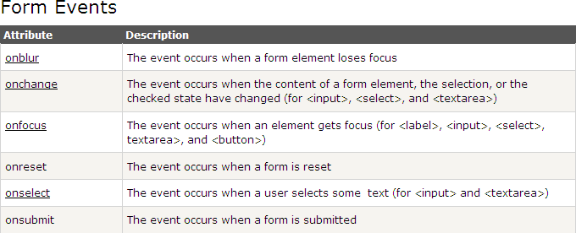

Slide 63
JavaScript Object Model
Models HTML documents in a very consistent and intuitive way
Provides an interface to access, navigate, and manipulate web page
DOM allows you to access and update the content, structure, and style of a document
To provide more interactive content on the Web
DOM allows HTML to be manipulated dynamically
Each HTML tag can be accessed and manipulated via its ID and NAME attributes
Each object has its own properties, methods, and events

Slide 64
The Object Model allows you to navigate along the document tree, up and down, and to the sides
You can use the child, parent, and sibling relationships to go from a particular point to any other point on your page tree
Model is divided into three sub-groups
Language objects
Form-field objects
Browser objects

Slide 65
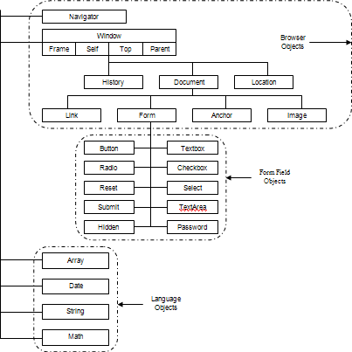

Slide 66
Browser Objects
navigator
window
document
location
history
anchor
link
frame
image

Slide 67
Form-Field Objects
Button
Checkbox
Radio
Text
Reset
Text Area
Password
Select
Submit
Hidden

Slide 68
Language Objects
Date
Array
Math
String

Slide 69
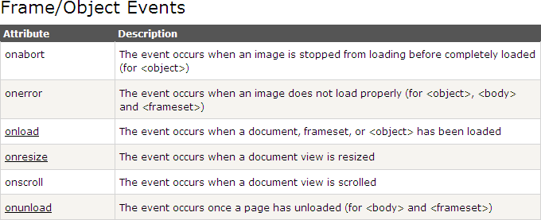

Slide 70
JavaScript Try...Catch Statement
The try...catch statement allows you to test a block of code for errors. The try block contains the code to be run, and the catch block contains the code to be executed if an error occurs.
There are two ways of catching errors in a Web page:
By using the try...catch statement (available in IE5+, Mozilla 1.0, and Netscape 6)
By using the onerror event. This is the old standard solution to catch errors (available since Netscape 3)

Slide 71
JavaScript Form Validation
JavaScript can be used to validate data in HTML forms before sending off the content to a server.
Form data that typically are checked by a JavaScript could be:
has the user left required fields empty?
has the user entered a valid e-mail address?
has the user entered a valid date?
has the user entered text in a numeric field?
E-mail Validation
The function below checks if the content has the general syntax of an email.
This means that the input data must contain an @ sign and at least one dot (.). Also, the @ must not be the first character of the email address, and the last dot must be present after the @ sign, and minimum 2 characters before the end.

Slide 72
Example
function validateForm()
{
var x=document.forms["myForm"]["fname"].valu e;
if (x==null || x=="")
{
alert("First name must be filled out"); return false;
}
}

Slide 73
Example
function validateForm()
{
var x=document.forms["myForm"]["email"].value; var atpos=x.indexOf("@");
var dotpos=x.lastIndexOf(".");
if (atpos<1 || dotpos<atpos+2 || dotpos+2>=x.length)
{
alert("Not a valid e-mail address"); return false;
}
}

Slide 74
The Window Object
The window object represents an open window in a browser.
If a document contain frames (<frame> or <iframe> tags), the browser creates one window object for the HTML document, and one additional window object for each frame.
Document Object
Each HTML document loaded into a browser window becomes a
Document object.
The Document object provides access to all HTML elements in a page, from within a script.
Tip: The Document object is also part of the Window object, and
can be accessed through the window.document property.
Note: The Document object can also use the properties and methods of the Node object.

Slide 75
The Window Object
The window object is supported by all browsers. It represent the browsers window.
All global JavaScript objects, functions, and variables automatically
become members of the window object.
Global variables are properties of the window object.
Global functions are methods of the window object.
Even the document object (of the HTML DOM) is a property of the window
object:
window.document.getElementById("header"); is the same as:
document.getElementById("header");

Slide 76
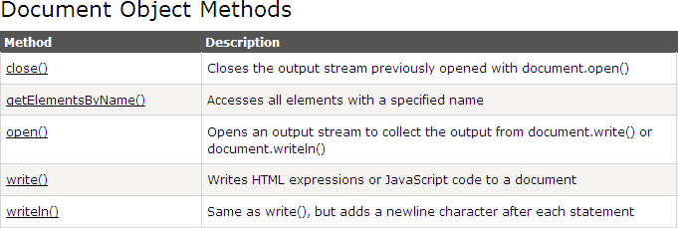
Document Object Methods

Slide 77
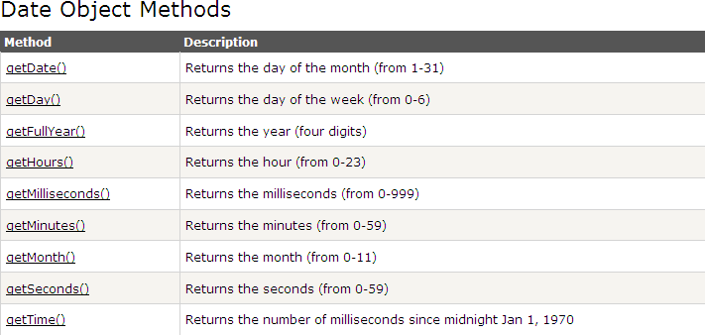
JavaScript Date Object

Slide 78
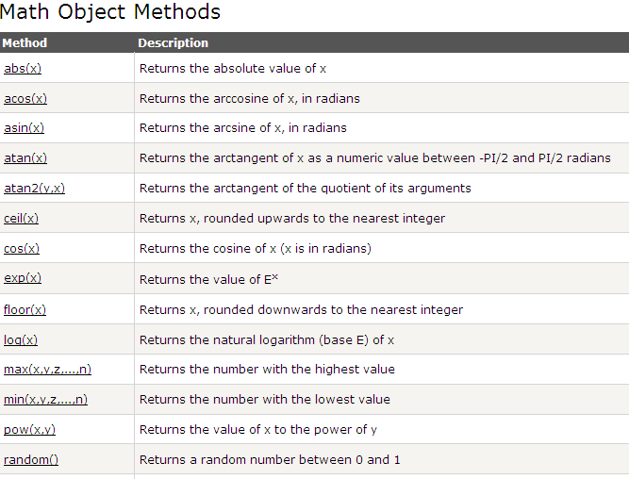
Math Object

